Slide 1
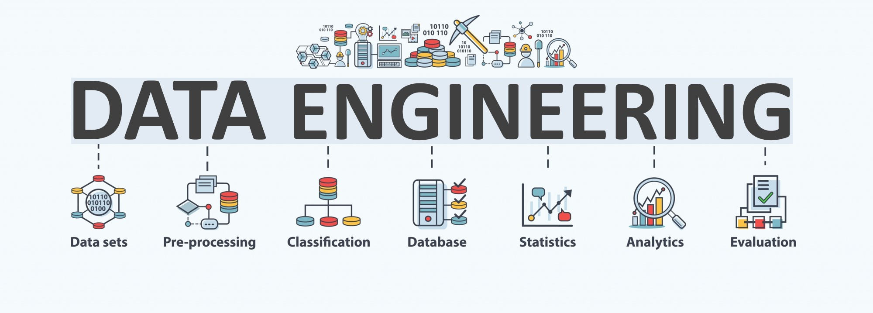

Lecture 11: Course Review
CS5481 Data Engineering
Instructor: Yifan Zhang

Slide 2
Outline
Course review
Final exam

Slide 3
L1: introduction
1. Overview of the data engineering ecosystem
2. Types of data
3. Languages and tools for data professionals

Slide 4

Big data is changing the way we do business and creating a need for data engineers who can collect and manage large quantities of data.
Data engineering is the practice of designing and building systems for collecting, storing, and analyzing data at scale.

Slide 5
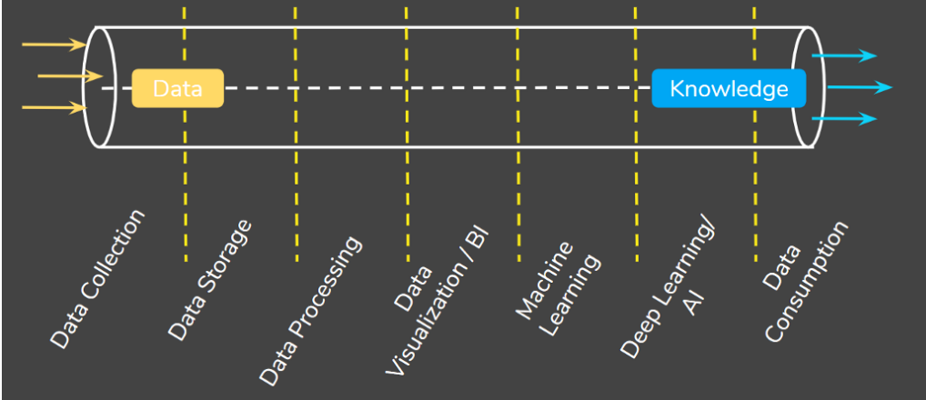
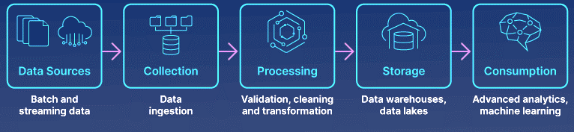
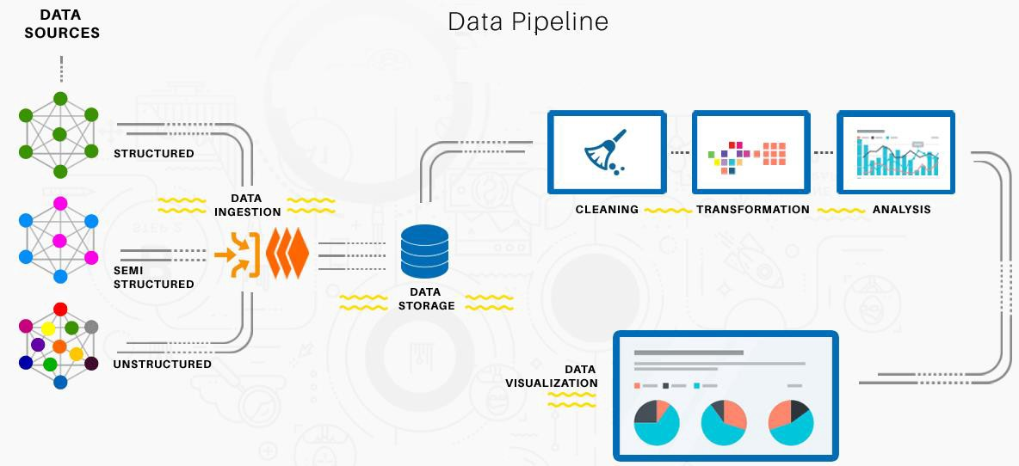
Data engineering pipeline
The Goal of Data Engineering is to provide organized, standard data flow to enable data-driven models such as machine learning models, data analysis.
Notes:
1. https://macxima.medium.com/data-engineering-572733412d54
2. https://www.analyticsvidhya.com/blog/2021/06/data-engineering-concepts-and-importance/

Slide 6
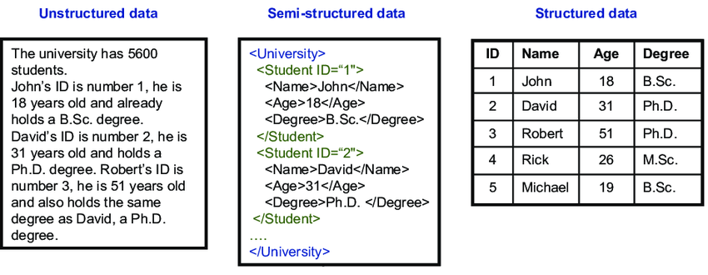
Types of data

Slide 7



Languages for data professionals
Query Languages
Programming Languages
Shell and Scripting Languages
For example, SQL for querying and manipulating data
For example, Python for developing data applications
For repetitive and time-consuming operational tasks

Slide 8
L2: data acqusition
1. Data sources
2. Web scraping
3. From web scraping to web crawling

Slide 9
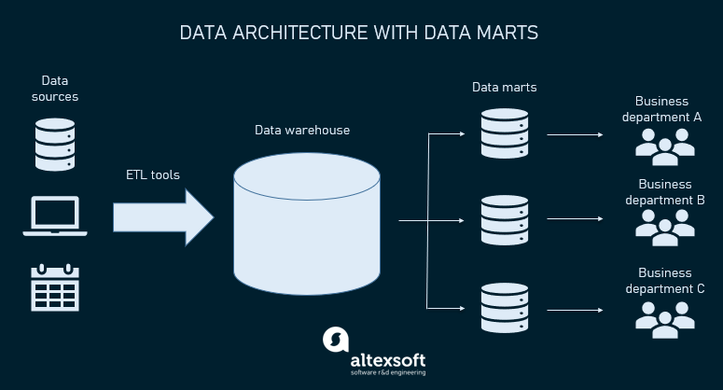
Sources of data
Relational databases
Flat files and XML datasets
APIs and web services
Notes:
https://www.altexsoft.com/blog/datascience/what-is-data-engineering-explaining-data-pipeline-data-warehouse-and-data-engineer-role/

Slide 10
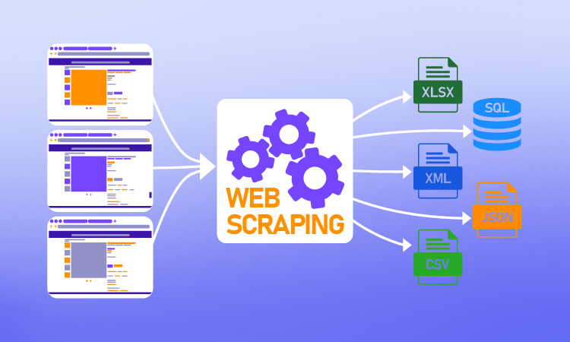
Web scraping
The construction of an agent to download, parse, and organize data from the web in an automated manner
Extract relevant data from unstructured sources on the Internet
Also known as screen scraping, web harvesting, and web data extraction
Can extract text, contact information, images, videos, product items, etc.

Slide 11
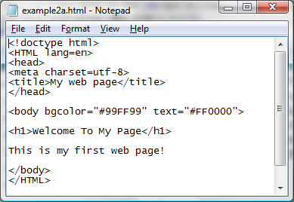
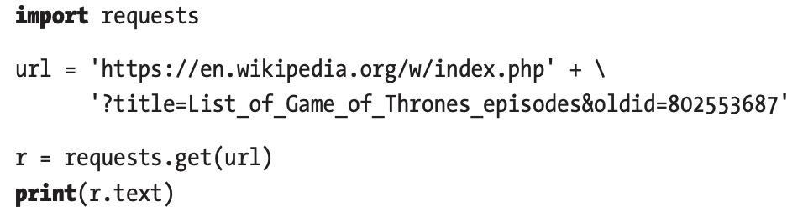
HTML file to scrape
HTML is a standard markup language for creating web pages.
HTML provides the building blocks to provide structure and formatting to documents.
Python ‘requests’ library could get the html content from a webpage.

Slide 12
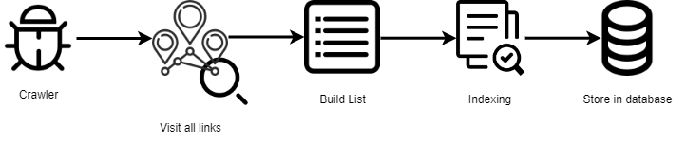
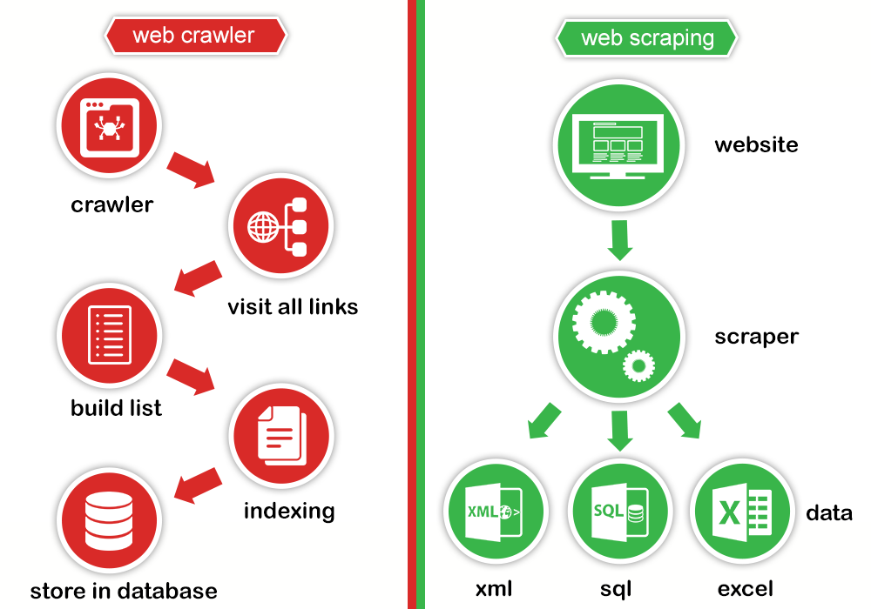
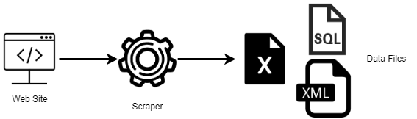
From web scraping to web crawling
Web Crawling: Using tools to read, copy and store the content of the websites for archiving or indexing purposes. Crawling usually deals with a network of webpages
Web Scraping: Extracting a large amount of specific
data usually from a single webpage or a single website

Slide 13
L3: data preprocessing
Why data preprocessing?
Data Cleaning
Data Integration
Data Transformation
Data Reduction
Data Discretization

Slide 14
Why data preprocessing - dirty data
Data in the real world is dirty: Lots of potentially incorrect data, e.g., instrument faulty, human or computer error, transmission error
Incomplete: lacking attribute values, lacking certain attributes of interest, or containing only aggregate data
e.g., Occupation=“ ” (missing data)
Noisy: containing noise, errors, or outliers
e.g., Salary=“−10” (an error)
Inconsistent: containing discrepancies in codes or names, e.g.,
Age=“42”, Birthday=“03/07/2010”
Was rating “1, 2, 3”, now rating “A, B, C”
discrepancy between duplicate records
Intentional (e.g., disguised missing data)
Jan. 1 as everyone’s birthday?

Slide 15
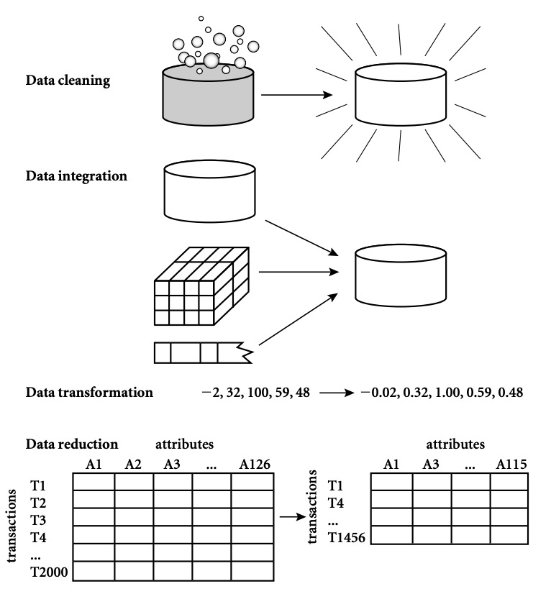
Major tasks in data preprocessing
Data cleaning: Fill in missing values, smooth noisy data, identify or remove outliers, and resolve inconsistencies.
Data integration: Integration of multiple databases, data cubes, files, or notes.
Data transformation: Normalization (scaling to a specific range), aggregation.
Data reduction: Obtains reduced representation in volume but produces the same or similar analytical results.
Data discretization: Reduce the number of values for a given continuous attribute by dividing the range of the attribute into intervals. Interval labels can then be used to replace actual data values.

Slide 16
Data cleaning – handling missing data
Ignore the tuple: usually done when class label is missing (assuming the task is classification—not effective in certain cases)
Fill in the missing value manually: tedious + infeasible
Automatically:
Use a global constant to fill in the missing value: e.g., “unknown”, a new class
Use the attribute mean to fill in the missing value
Use the attribute mean for all samples of the same class to fill in the missing value: smarter
Use the most probable value to fill in the missing value: inference-based such as regression, Bayesian formula, decision tree

Slide 17
Data cleaning – handling noisy data
Binning method
First sort data and partition into bins
Then one can smooth by bin means, median, and boundaries, etc.
Used also for discretization
Clustering
Detect and remove outliers
Semi-automated method
Combined computer and human inspection
Detect suspicious values and check manually
Regression
Smooth by fitting the data into regression functions

Slide 18
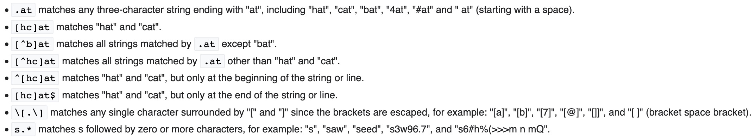
A useful tool: Regular expressions (Regex)
What is Regex
A regular expression is a sequence of characters that specifies a search pattern in text.
It can be used when
testing the pattern within the string
identify specific text in a document, delete the text completely, or replace it with other text
extract substrings from strings based on pattern matching
Regex examples
Refer to https://en.wikibooks.org/wiki/Regular_Expressions

Slide 19
Data transformation
Normalization: scaled to fall within a small, specified range
min-max normalization
z-score normalization
normalization by decimal scaling
Attribute/feature construction
New attributes constructed from the given ones

Slide 20
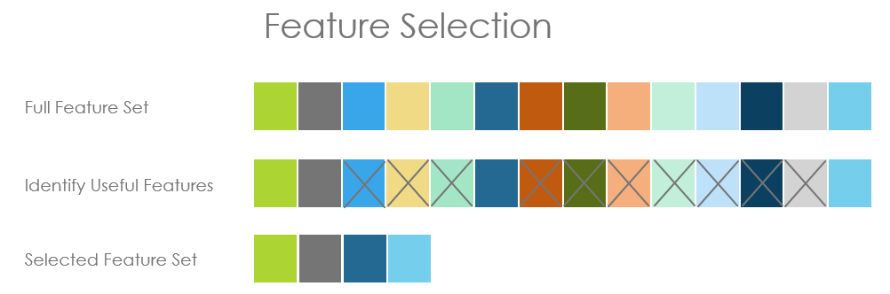
Data reduction example – dimensionality reduction
Feature selection (i.e., attribute subset selection):
Select a minimum set of features such that the probability distribution of different classes given the values for those features is as close as possible to the original distribution given the values of all features.
Nice side-effect: reduces # of attributes in the discovered patterns, easier to understand.

Slide 21
Data discretization
Discretization and concept hierarchy generation for numeric data
Hierarchical and recursive decomposition using:
Binning (data smoothing)
Histogram analysis (numerosity reduction)
Clustering analysis (numerosity reduction)
Entropy-based discretization
Segmentation by natural partitioning

Slide 22
L4: data visualization
Introduction to Data Visualization
Conventional Visualizations
Data Visualization Skills
Tips and Tricks
Data Visualization Traps
Visualization and Dashboard Software

Slide 23
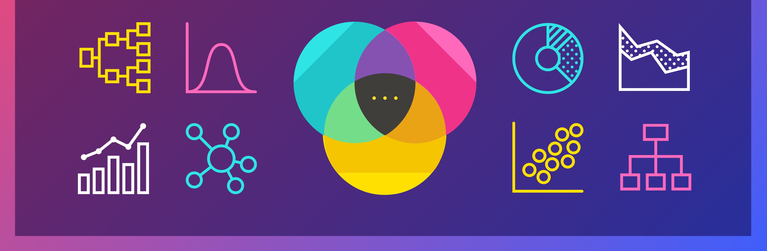
Data visualization
Data visualization is the study of visual representations of abstract data to reinforce human cognition. Its goal is to make information easy to comprehend, interpret, and retain.
The discipline of communicating information through the use of visual elements such as graphs, charts, and maps.

Slide 24
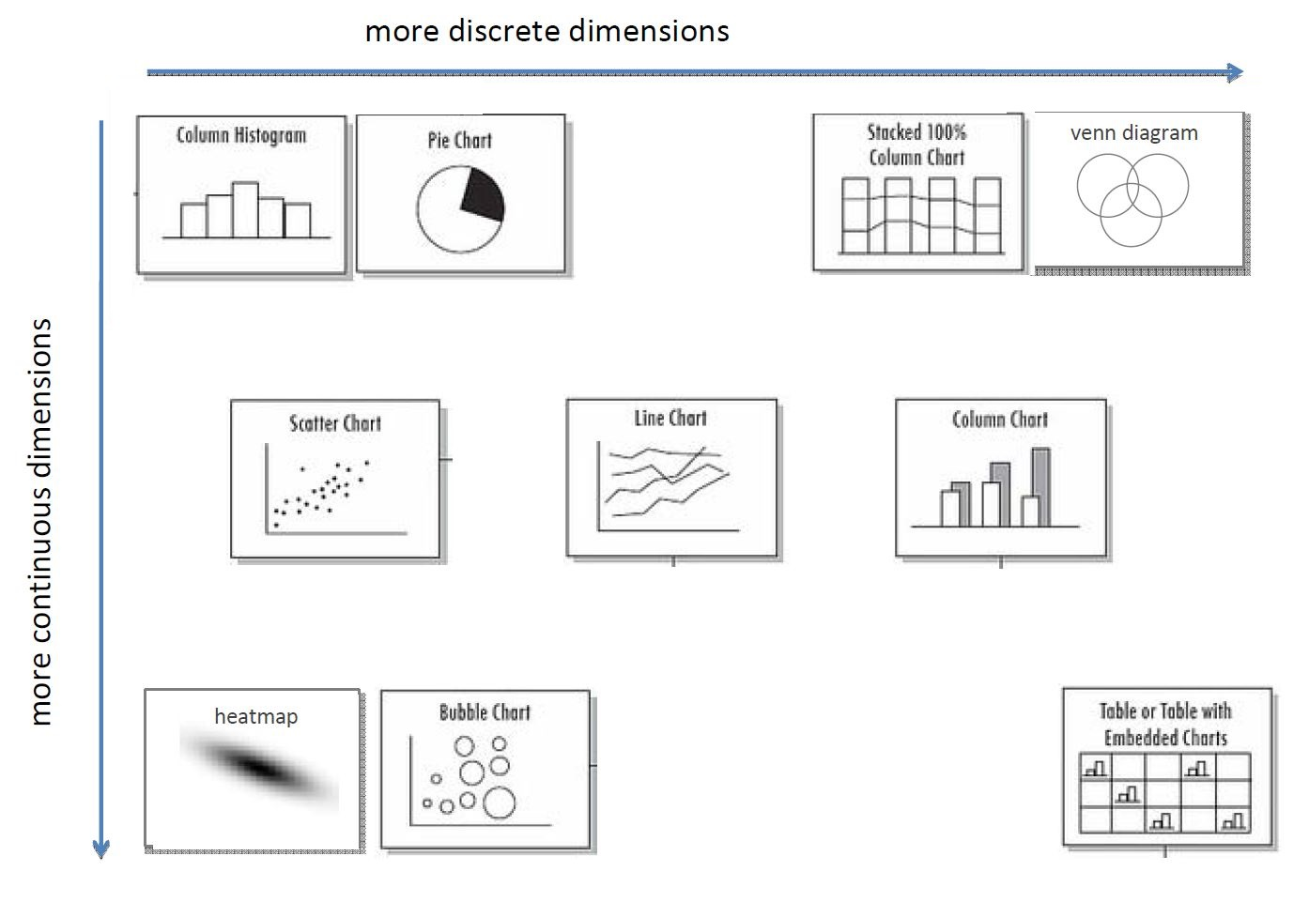
Conventional visualizations

Slide 25
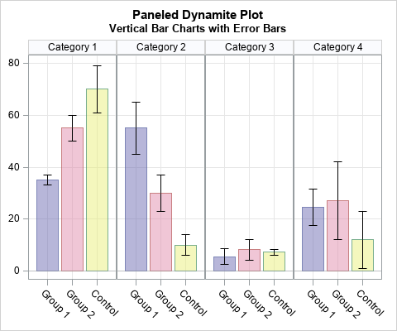
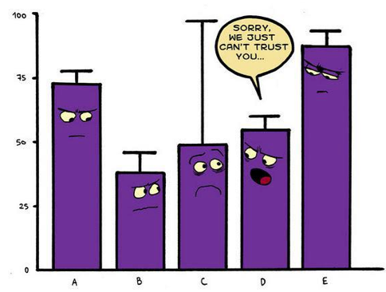
Visualization example – dynamite plots
Dynamite Plot
Can be used for lots of discrete grouping factors.
Natural semantics of grouping
Conceals data.

Slide 26
Data visualization skills
There are usually 6 reasons to make a chart:
To compare
To show the distribution
To explain parts of the whole
To tell the trend over time
To find out the deviations
To understand the relationship

Slide 27
2 tradeoffs
Informativeness vs. readability
Too little information can conceal data.
But too much information can be overwhelming.
Possible solution: hierarchical organization.
Data-centric vs. viewer-centric
Viewers are accustomed to certain types of visualization.
But novel visualization can be truer to data.

Slide 28
L5: data indexing
Data Storage
Records and Files
Hashed Files
Indexing Techniques
Tree Data Structure

Slide 29
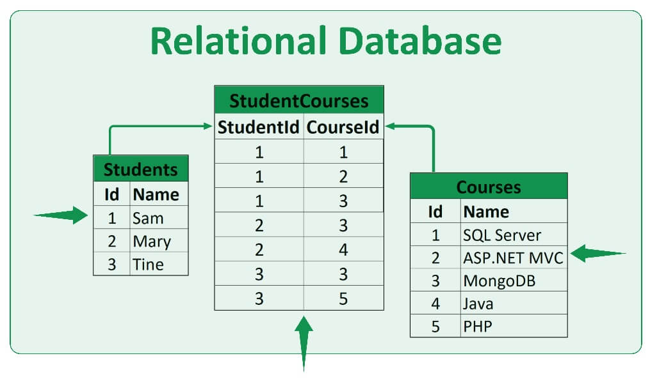
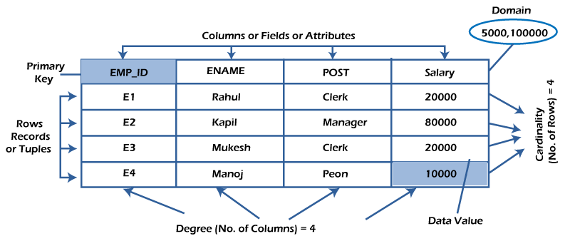
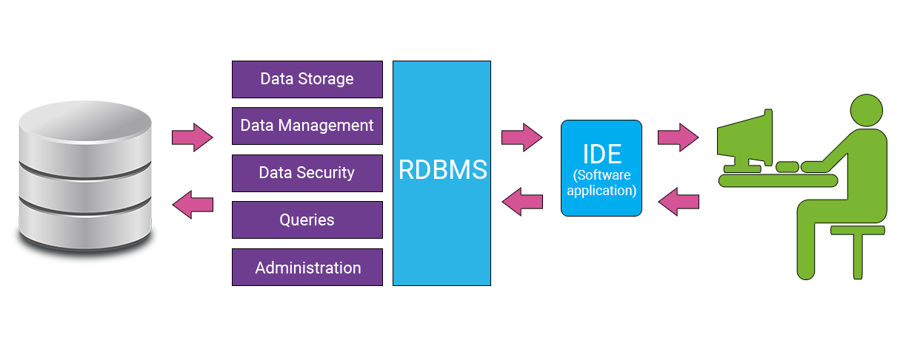
Relational databases
A relational database is based on the relational model of data.
A relational database management system (RDBMS) is a system to maintain relational databases.
Many relational database systems are equipped with the option of using the SQL (Structured Query Language) for querying and maintaining the database.

Slide 30
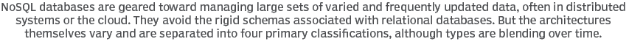
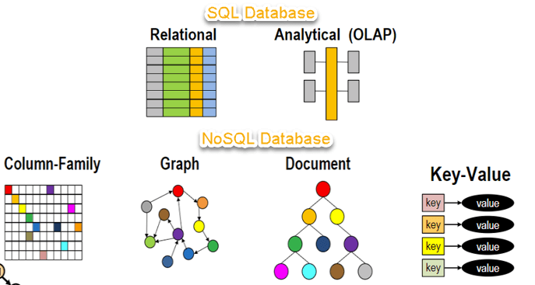
NoSQL databases
NoSQL stands for:
No Relational
No RDBMS
Not Only SQL
NoSQL is an umbrella term for all databases and data stores that don’t follow the RDBMS principles
A class of products
A collection of several (related) concepts about data storage and manipulation
Often related to large data sets

Slide 31
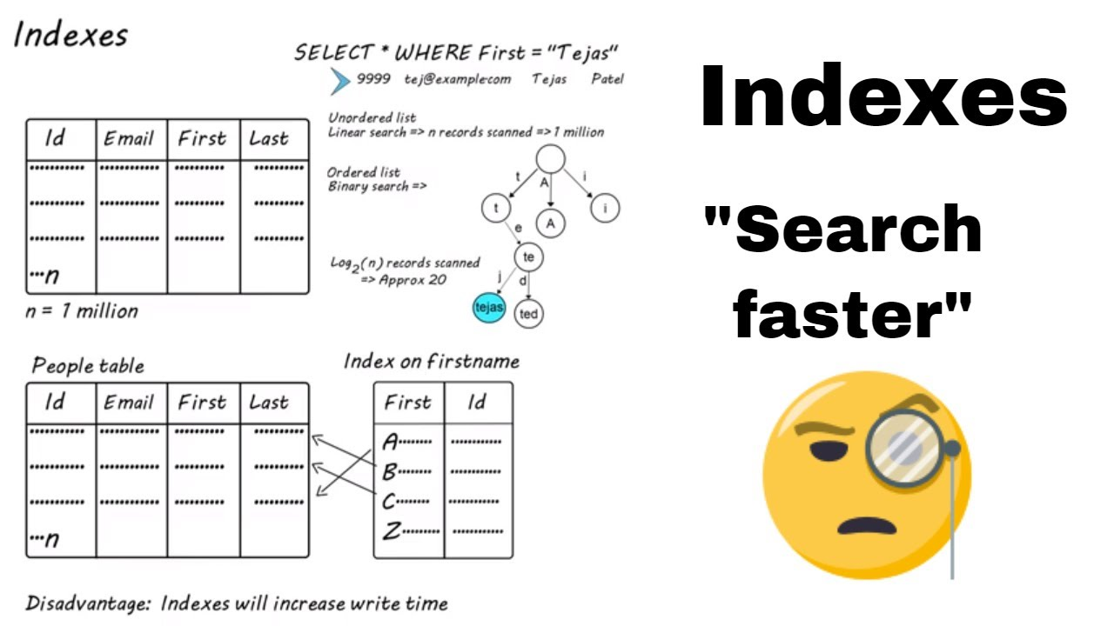
Data indexing
A database index is a data structure that improves the speed of data retrieval operations on a database table at the cost of additional writes and storage space to maintain the index data structure.
Unordered records (Heap files)
Ordered records (Sorted files)
Hashed records

Slide 32
B and B+ tree data structure for indexing
B+ tree index
Most implementations of a dynamic multilevel index use a variation of the B-tree data structure called a B+-tree.
In a B+-tree, data pointers are stored only at the leaf nodes of the tree.
The pointers in internal nodes are tree pointers to blocks that are tree nodes.
The pointers in leaf nodes are data pointers to the data file records.
Because entries in the internal nodes of a B+-tree does not include data pointers, more entries (tree pointers) can be packed into an internal node and thus fewer levels (higher capacity).
The leaf nodes of a B+-tree are usually linked to provide ordered access on the search field to the records.

Slide 33
L6: data querying
Overview of data querying
Relational algebra and SQL querying
NoSQL querying

Slide 34
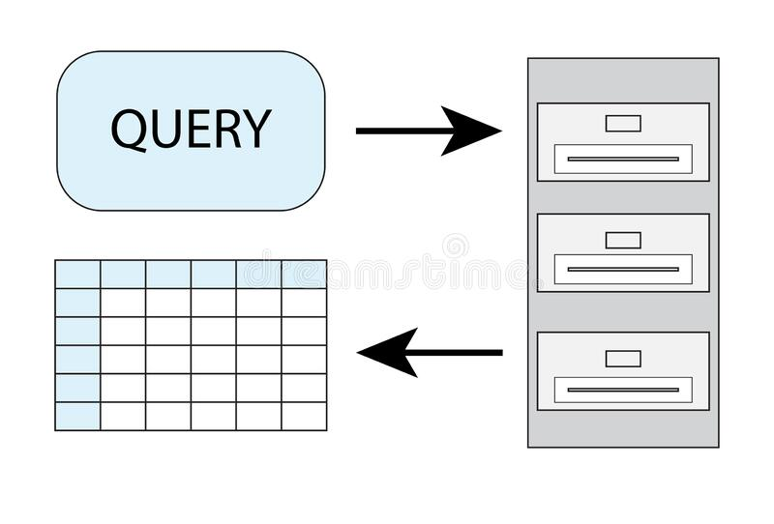
Data querying
A data query is either an action query or a select query.
A select query is one that retrieves data from a database.
An action query asks for additional operations on data, such as insertion, updating, deleting or other forms of data manipulation.

Slide 35
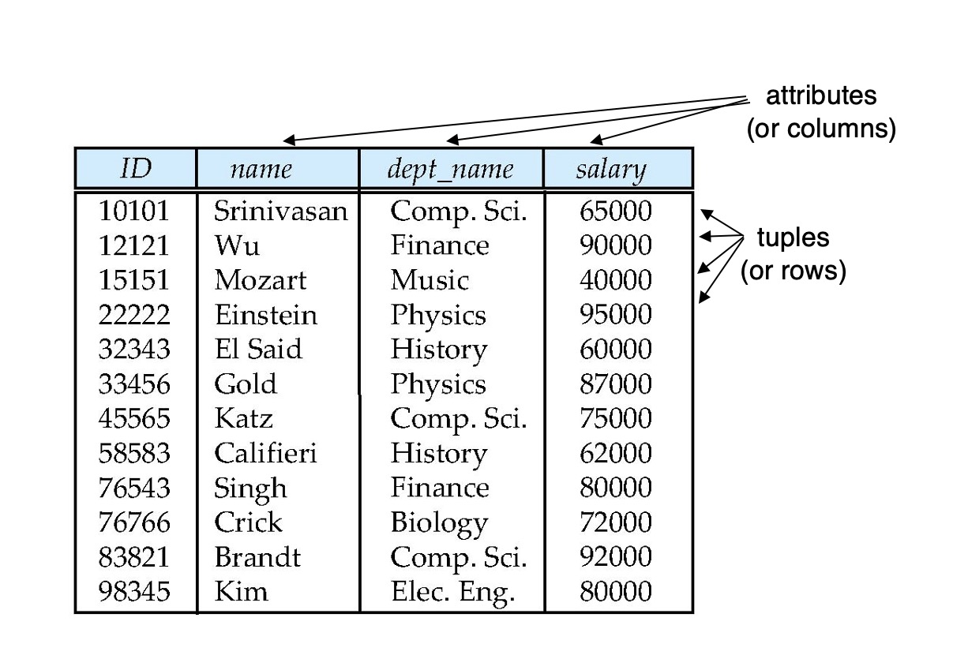
Relational databases and relational algebra
Six basic operators
select: σ
project: ∏
union: ∪
set difference: –
Cartesian product: x
rename: ρ
Additional operations that simplify common queries
set intersection
join
assignment
outer join
Relational databases
Relational algebra

Slide 36
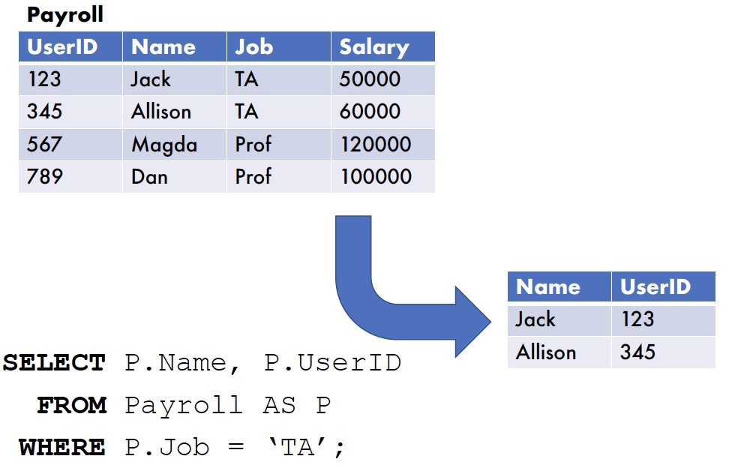
SQL – Select
Select <List of Columns and expressions (usually involving columns)>
From <List of Tables & Join Operators>
Where <List of Row conditions joined together by And, Or, Not>
Group By <list of grouping columns>
Having <list of group conditions connected by And, Or, Not >
Order By <list of sorting specifications>

Slide 37

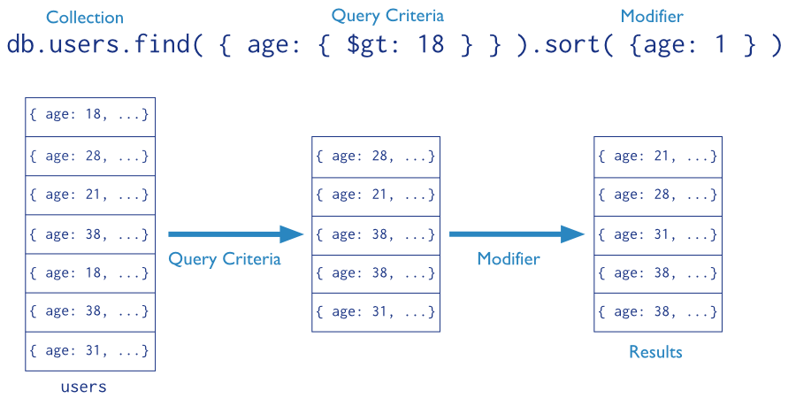
NoSQL querying – document databases as an example
E.g., MongoDB querying: Mongo query language
Targets a specific collection of documents
Specifies criteria that identify the returned documents
May include a projection to specify returned fields
May impose limits, sort, orders, …
Basic query - all documents in the collection:
db.users.find()
db.users.find( {} )
E.g.,
db.inventory.find({ type: "snacks" })
All documents from collection inventory where the type field has the value snacks
db.inventory.find({ type: { $in: [ 'food', 'snacks' ] } } )
All inventory docs where the type field is either food or snacks
db.inventory.find( { type: 'food', price: { $lt: 9.95 } } )
All ... where the type field is food and the price is less than 9.95

Slide 38
L7&L8: data-driven applications
Information retrieval
Recommendations
Social network analysis
Anomaly detection

Slide 39
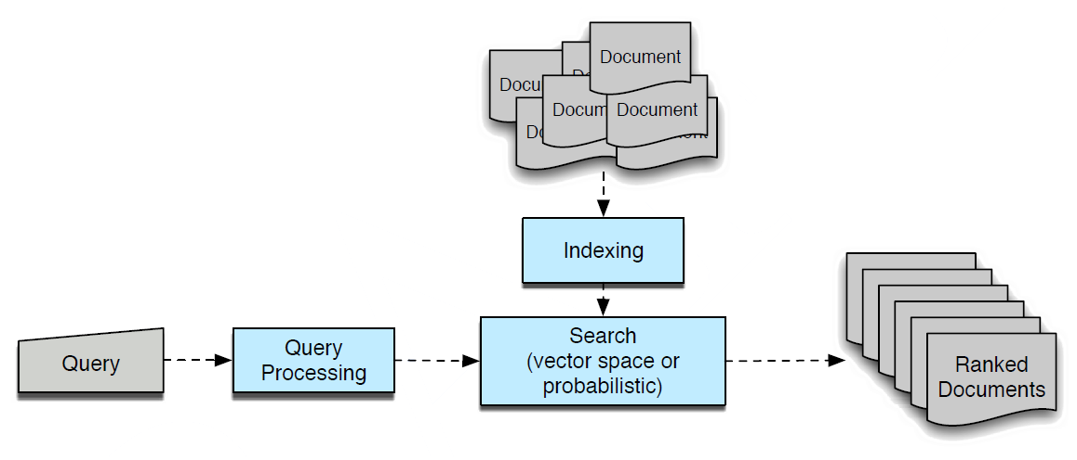
Process of information retrieval
Some of the key issues
Information need: query and query processing
Relevance: indexing documents and search algorithm
Evaluation: document ranking, precision-recall, etc.

Slide 40
How to find relevant documents for a query?
By keyword matching
Boolean model
By similarity
Vector space model
By imaging how to write out a query
How likely a query is written with this document in mind.
Generate with some randomness
Query generation language model
By trusting how other web pages think about the web page
Pagerank, hits
By trusting how other people find relevant documents for the same or similar query
Learning to rank

Slide 41
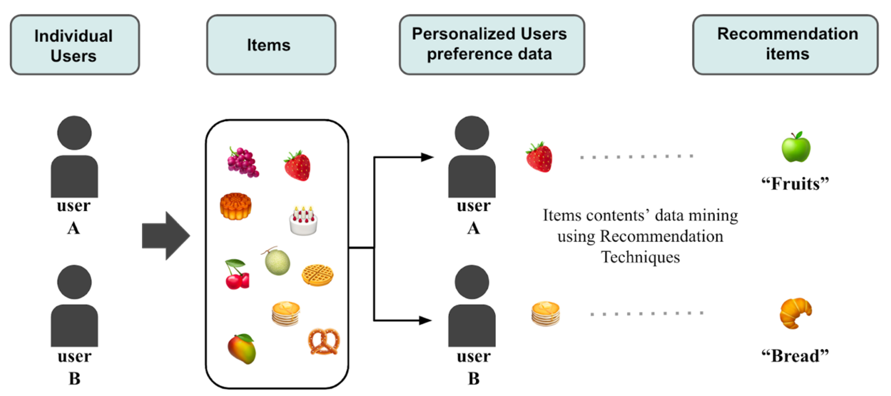
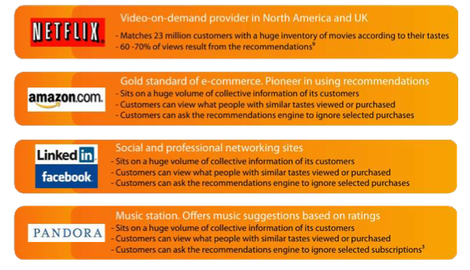
Recommender systems
Recommender systems: a subclass of information filtering system that provide suggestions for items that are most pertinent (of interest) to a particular user.

Slide 42
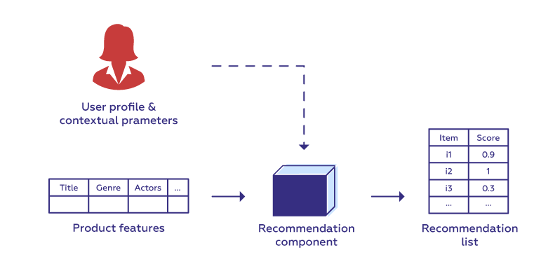
Collaborative filtering
collaborative filtering
neighborhood methods
latent factor models
Item/User based collaborative filtering: find similar items/users and recommend similar items.
Matrix factorization: represent each item and user as an embedding vector and calculate their preference score (e.g., inner product).
Item based collaborative filtering
User based collaborative filtering
Matrix factorization
A user/An item profile is a collection of settings and information associated with a user/an item.

Slide 43
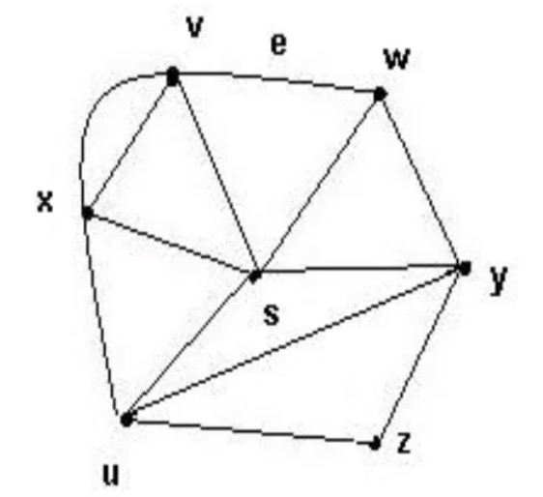
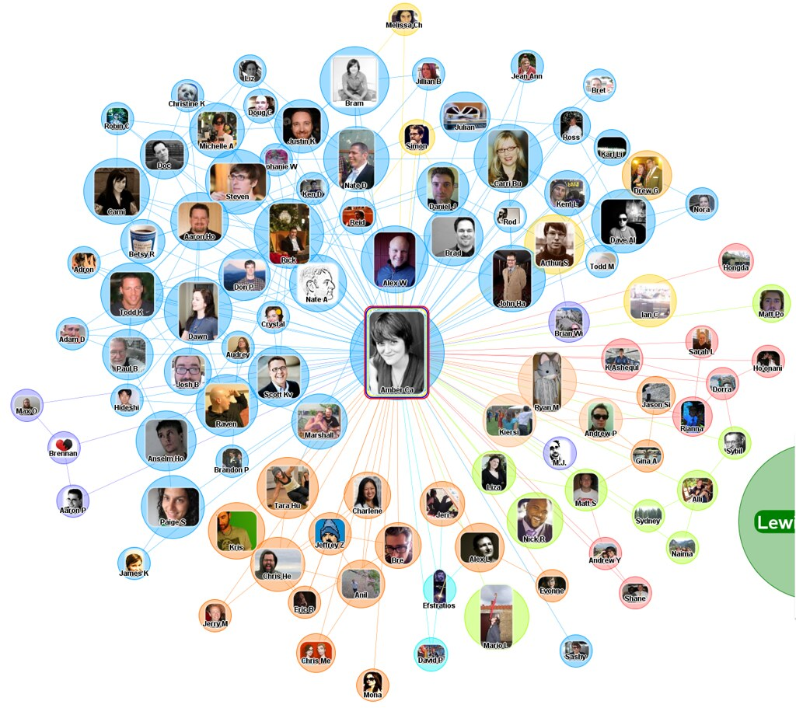
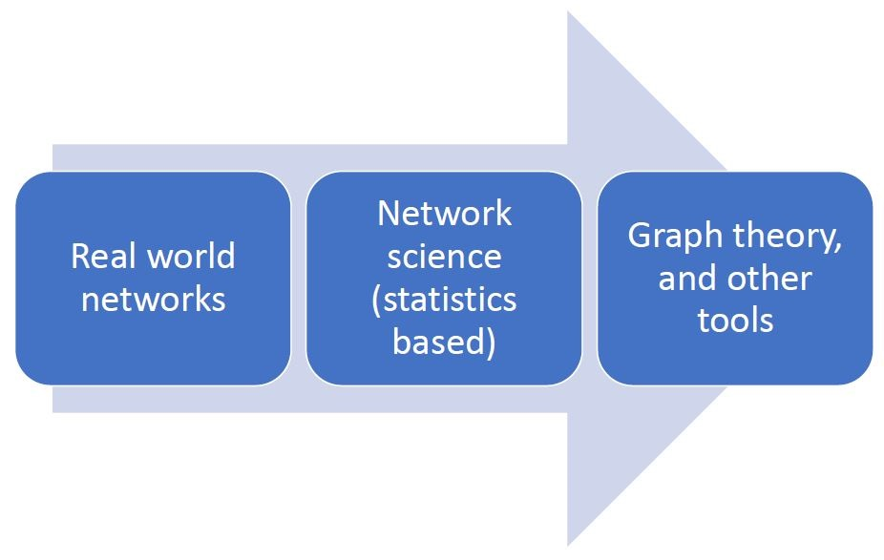
Social network analysis – graph theory
Graph theory is a branch of discrete mathematics concerned with proving theorems and developing algorithms for arbitrary graphs (e.g. random graphs, lattices, hierarchies).
Graph theory and network science

Slide 44
Sociograms
A sociogram is a graphic representation of social links that a person has. It is a graph drawing that plots the structure of interpersonal relations in a group situation.
Peripheral individual
Nodes are individuals or organizational units
Cluster
Central individual
Links represent relationships (e.g. “friend of”), mono or bi-directional

Slide 45
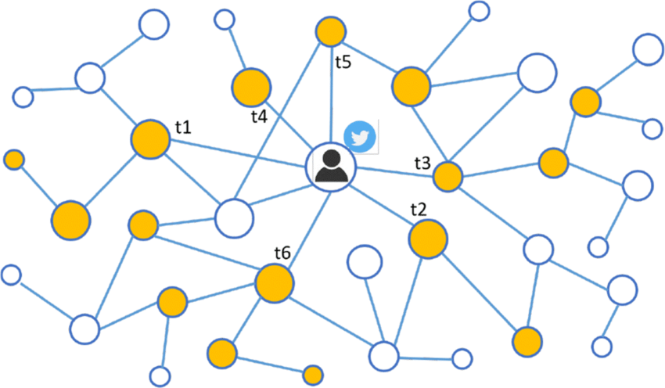




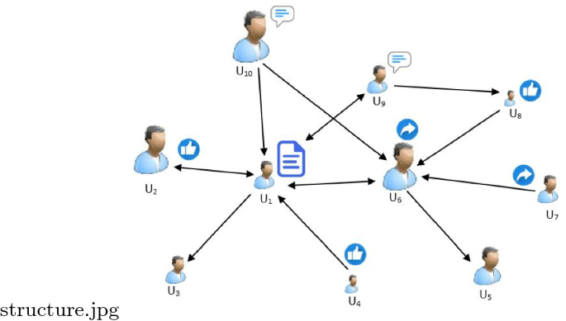
Social network analysis example – network propagation
Network propagation refers to a class of algorithms that integrate information from input data across connected nodes in a given network.
Study the dynamics of network propagation, i.e., how data/information is spread across networks, and how networks are influenced in the meantime.
Epidemic/Virus spread model
Applications
News/Tweets/Memes/Trends propagation
Rumer/Fake news detection
Tweets propagation
Memes = social genes
Fake news detection

Slide 46
Anomaly detection overview
Anomaly detection: the identification of rare items, events or observations which deviate significantly from the majority of the data and do not conform to a well defined notion of normal behavior.
Historically, the field of statistics tried to find and remove outliers as a way to improve analyses.
There are now many fields where the outliers / anomalies are the objects of greatest interest.
The rare events may be the ones with the greatest impact, and often in a negative way.

Slide 47
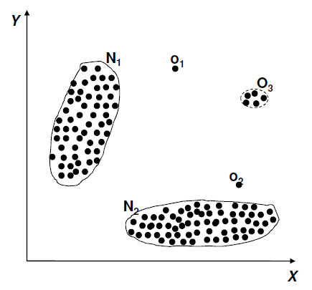
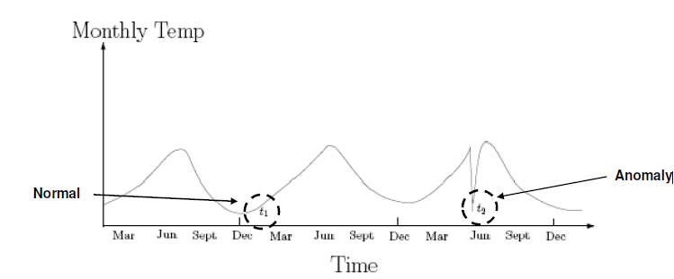
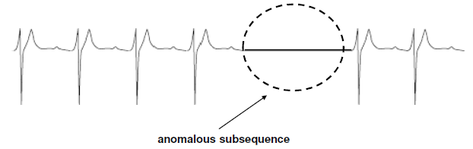
Structure of anomalies
Point anomalies
Contextual anomalies
Collective anomalies

Slide 48
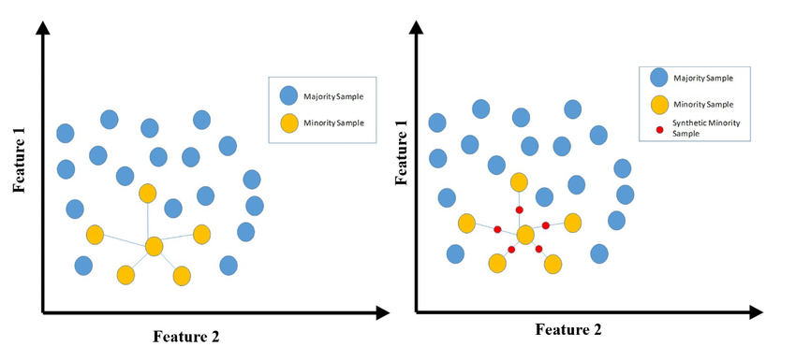
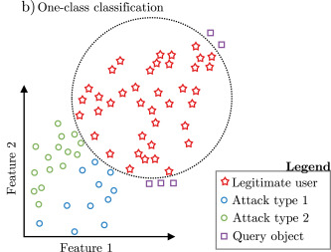
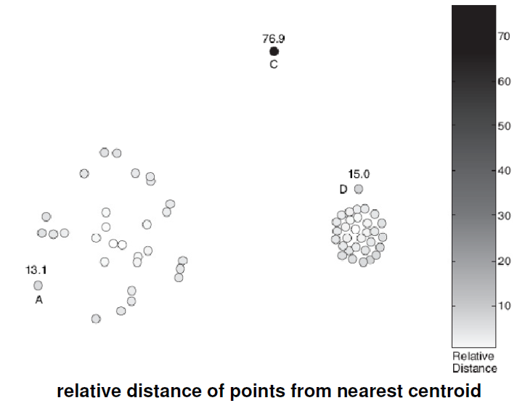
Data labels for anomaly detection
Supervised anomaly detection
Labels available for both normal data and anomalies
Similar to classification with high class imbalance
Data augmentation solution: SMOTE (Synthetic Minority Oversampling TEchnique) is an oversampling technique where the synthetic samples are generated for the minority class.
Semi-supervised anomaly detection
Labels available only for normal data
One class classification solution: only learning normal pattern
Unsupervised anomaly detection
No labels assumed
Based on the assumption that anomalies are very rare compared to normal data

Slide 49
L9: data management
What is Data Management
Data Quality
Data Security
Data Privacy

Slide 50
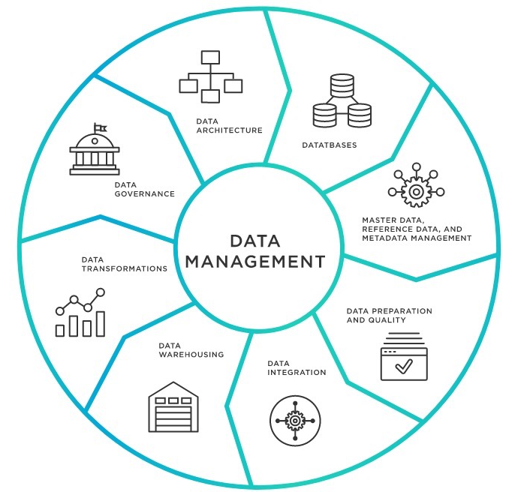
What is data management?
Data management is the practice of collecting, keeping, and using data securely, efficiently, and cost-effectively.
As organizations create and consume data at unprecedented rates, data management solutions become essential for making sense of the vast quantities of data.
Today’s leading data management software ensures that reliable, up-to-date data is always used to drive decisions.

Slide 51
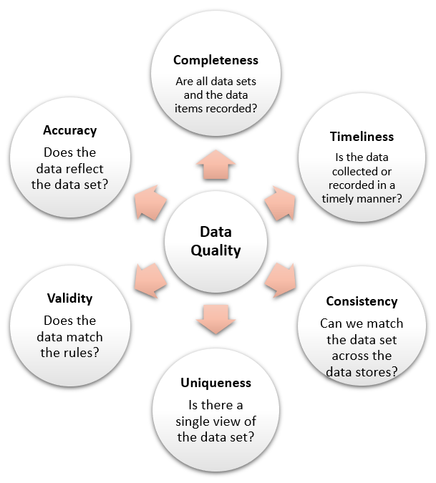
Data quality dimensions
Six main dimensions of data quality
Accuracy: The data should reflect actual, real-world scenarios; the measure of accuracy can be confirmed with a verifiable source.
Completeness: Completeness is a measure of the data’s ability to effectively deliver all the required values that are available.
Consistency: Data consistency refers to the uniformity of data as it moves across networks and applications. The same data values stored in difference locations should not conflict with one another.
Validity: Data should be collected according to defined business rules and parameters, and should conform to the right format and fall within the right range.
Uniqueness: Uniqueness ensures there are no duplications or overlapping of values across all data sets. Data cleansing and deduplication can help remedy a low uniqueness score.
Timeliness: Timely data is data that is available when it is required. Data may be updated in real time to ensure that it is readily available and accessible.

Slide 52
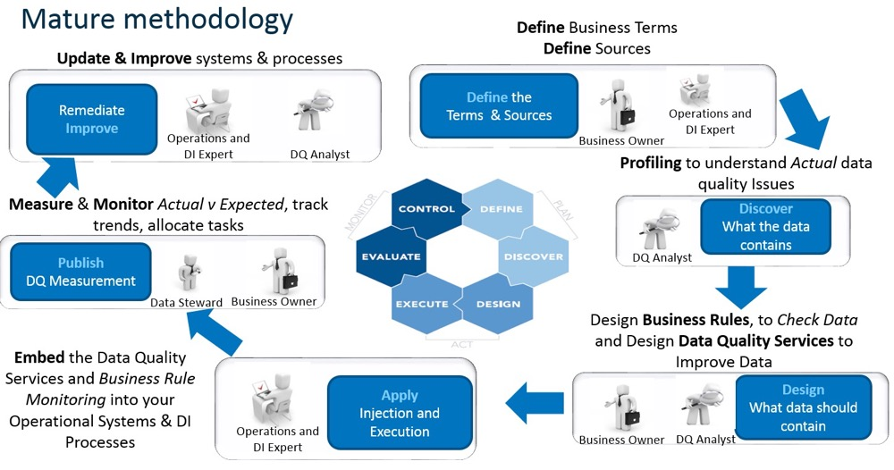
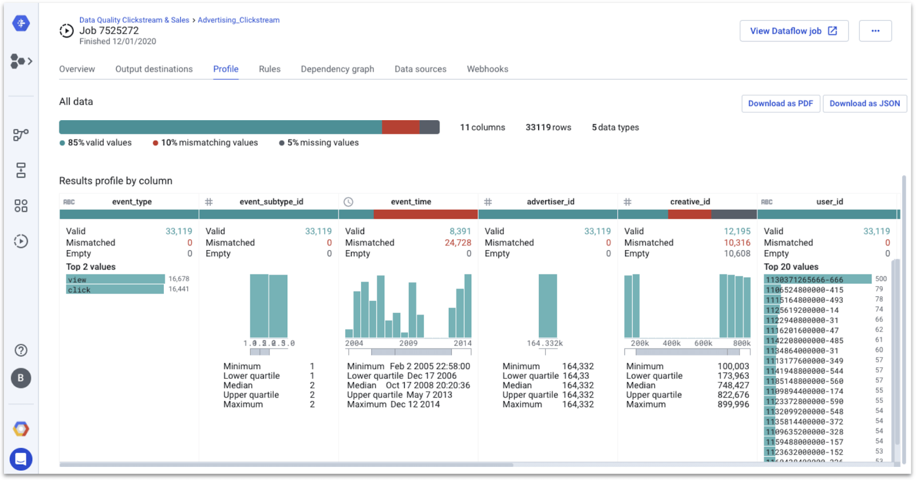
How to improve data quality? An example
Data quality monitoring - frequent data quality checks are essential. Data quality software in combination with machine learning can automatically detect, report, and correct data variations based on predefined business rules and parameters.

Slide 53
What is data security?
Data security is the process of safeguarding digital information throughout its entire life cycle to protect it from corruption, theft, or unauthorized access.
It covers everything—hardware, software, storage devices, and user devices; access and administrative controls; and organizations’ policies and procedures.
Data security uses tools and technologies that enhance visibility of a company's data and how it is being used. These tools can protect data through processes like data masking, encryption, and redaction of sensitive information. The process also helps organizations streamline their auditing procedures and comply with increasingly stringent data protection regulations.

Slide 54

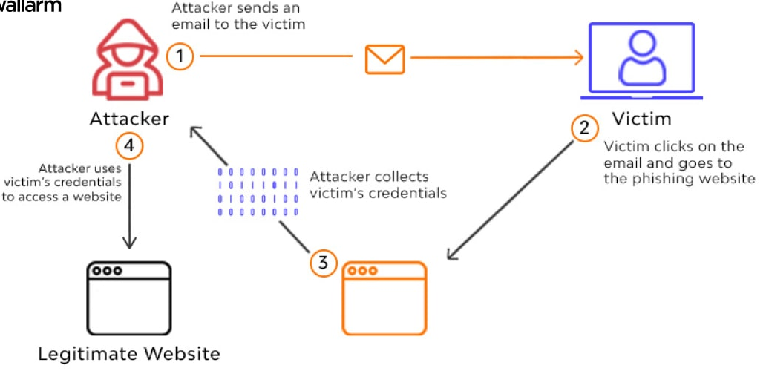

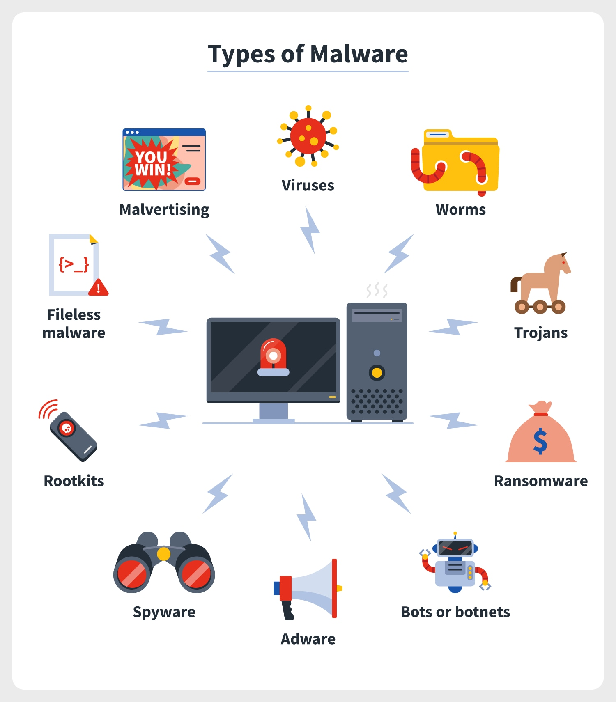
Data security risks example
Phishing Attacks
In a phishing attack, a cyber criminal sends messages, typically via email, short message service (SMS), or instant messaging services, that appear to be from a trusted sender. Messages include malicious links or attachments that lead recipients to either download malware or visit a spoofed website that enables the attacker to steal their login credentials or financial information.
Malware
Malicious software is typically spread through email- and web-based attacks. Attackers use malware to infect computers and corporate networks by exploiting vulnerabilities in their software, such as web browsers or web applications. Malware can lead to serious data security events like data theft, extortion, and network damage.

Slide 55


How to achieve data security? An example
Data Masking
Data masking enables an organization to hide data by obscuring and replacing specific letters or numbers. This process is a form of encryption that renders the data useless should a hacker intercept it. The original message can only be uncovered by someone who has the code to decrypt or replace the masked characters.

Slide 56



Data privacy
Data privacy generally means the ability of a person to determine for themselves when, how, and to what extent personal information about them is shared with or communicated to others, or being used.
This personal information can be one's name, location, contact information, or online or real-world behavior.

Slide 57

Privacy preserving method example: data perturbation
Perturb data with value distortion
User provides x_{i}+r instead of x_{i}
r is a random value
Uniform, uniform distribution between [-α, α]
Gaussian, normal distribution with μ = 0, σ
Alice’s age
30 | 70K | ...
50 | 40K | ...
...
Add random number to Age
Randomizer
Randomizer
35 | 80K | ...
47 | 54K | ...
...
30 becomes 35 (30+5)
Reconstruct
Distribution
of Age
Reconstruct
Distribution
of Salary
Privacy-performance tradeoff
More noises
higher privacy, lower performance
...
Classification
Algorithm
Model

Slide 58
L10: advanced topics and recent trends
Representation learning and multimodal learning
Data bias issues
Explainability

Slide 59






Deep learning for representation learning
Deep learning maps images, texts, speeches, etc. into vectors in representation spaces. If downstream tasks are trained together, then it is end-to-end.
Image pixels
Speech signal waves
Text tokens (words)
Representations
(latent vectors)
Downstream tasks

Slide 60


Multiple modalities
There are multiple types of modalities.

Slide 61

Core technical parts
Representation
Alignment
Fusion
Translation
Co-learning

Slide 62


Pay attention to bias and fairness issues!
Bias is across the data engineering pipeline!

Slide 63
Explainability
Explainability can be defined as to “understand how a model arrives at its result, also referred to as the outcome explanation problem.” If end-users are able to understand the reasoning behind the prediction, then it is assumed more trust will grow.
Furthermore, this allows for a positive feedback loop from user to development interactions. Some characterizations of explainability include explanations for individual predictions or the model’s prediction process as a whole.

Slide 64


Example: LIME surrogate model
LIME for Local Interpretable Model-agnostic Explanations

Slide 65
Assessment
Continuous assessment (60%)
2 individual homework assignments (each 15%)
1 group project with presentations (30%)
Final exam (40%)

Slide 66
Final exam
It will be a closed-book exam. No materials and electronics are allowed.
The scope of the exam includes all lectures, tutorials, and homework assignments.
The key focus will be put on understanding basic concepts and principles, understanding fundamentals techniques, analyzing advantages and disadvantages of different techniques, and proposing solutions for specific problems.
There will be in total 5 questions.
Short questions to ask your understanding of some concepts, principles, reasons, key features of some techniques, etc. (around 50%)
A little bit design, analysis, calculation, program, etc. (around 50%)
We will hold an office hour via Zoom/Teams (to be announced later) to answer questions approximately one week before the final exam. Welcome to join if you have questions.

Slide 67
Group project presentation
Time arrangement
April 16: 9:30 – 11:30
8 mins for each group, including 5-min presentation + 3-min Q&A.
The evaluation of your group project will be based on your overall work quantity and quality, novelty, organization and logic of oral and written presentations, your contribution to the group project, etc.
Mode: offline

Slide 68
Thanks for your attention!

